Slide 1
Networking Basics
Carlos Gross Jones

Slide 2
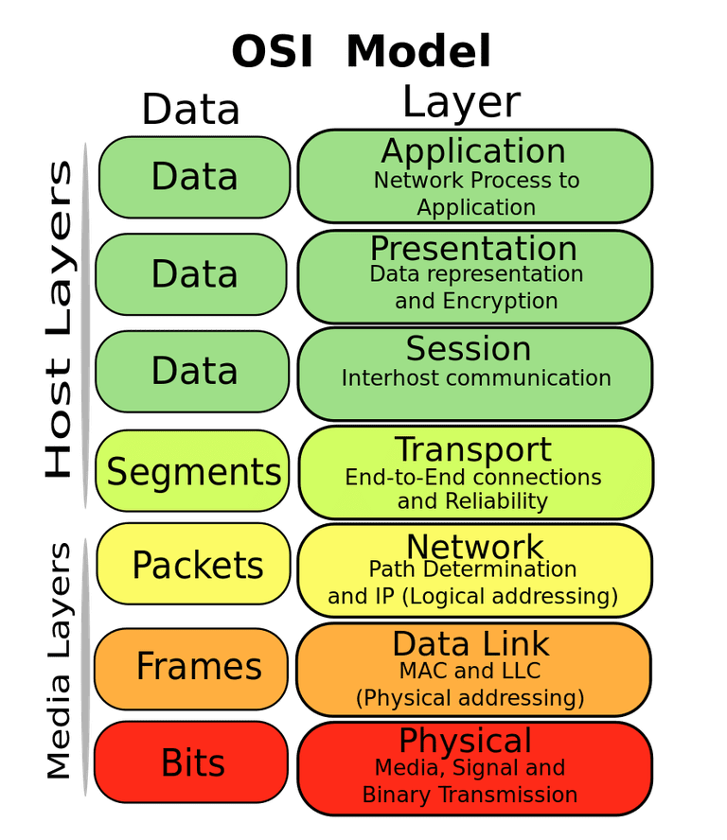
OSI Model (A.K.A. “seven-layer model”)
Each layer encodes or encapsulates data from the layer above
A given layer shouldn’t care about how the layer below encodes its data
E.g., the data link layer shouldn’t care if its data is encoded as electrical signals on copper wire or pulses of light in a fiber in the physical layer

Slide 3
Physical Layer

Slide 4
Physical Layer
The physical layer encodes bits of data into some phenomenon in the physical world
Examples:
Voltage pulses on copper wire
Laser pulses in an optical fiber
Phase modulation in a radio signal

Slide 5
“Ethernet”
Technically, Ethernet (IEEE 802.3) is a layer 2 (Data Link) standard
It’s possible to send Ethernet frames over optical fiber, for example
“Ethernet” is colloquially used to refer to:
10/100/10GBASE-T physical implementations
The 8P8C modular connector

Slide 6
10/100/1GBASE-T
Layer 1 (Physical) implementation of Ethernet over twisted-pair cable
10, 100, and 1G are used to refer to bitrates of 10 MBPS, 100 MBPS, and 1 GPBS, respectively
“Base” means baseband signaling (i.e., very narrow frequency range)
“T” stands for twisted pair cable
E.g., “100BASE-T” is a protocol that encodes Ethernet frames at 100 MBPS, using baseband signaling, on twisted-pair cable

Slide 7
Twisted Pair Cable
Differential signaling:
Uses wires in pairs, instead of n wires and a ground
Improves noise immunity
Allows isolation to prevent ground loops
Pairs of wires are twisted to reduce vulnerability to interference and crosstalk

Slide 8
Differential Signaling
Data is encoded as the difference between two signals
On the transmission end, the original signal is sent, plus an inverted copy
On the reception end, the inverted copy is subtracted from the noninverted signal
Common-mode noise cancels out

Slide 9
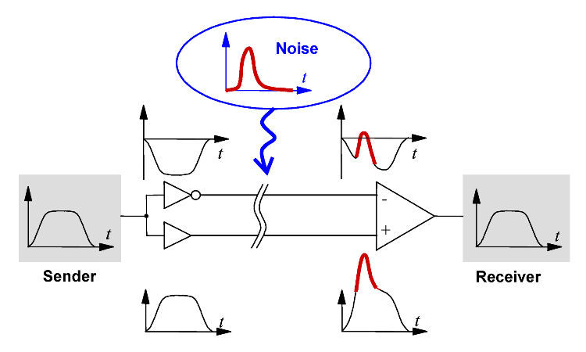

Differential Signaling
$f\left(t\right), −f(t)$ are sent
Noise ($n(t)$) is added to both
At the receiver, the difference is found:
$\left[f\left(t\right)+n(t)\right]−\left[−f\left(t\right)+n\left(t\right)\right]=2f(t)$

Slide 10
Cat 5e
Most common “Ethernet” cables
Refers to “Category 5, enhanced”
Cat 3, cat 5, etc. are standards published by the Telecommunications Industry Association (TIA)
Consists of four pairs: orange/orange-white, green/green-white, blue/blue-white, and brown/brown-white

Slide 11
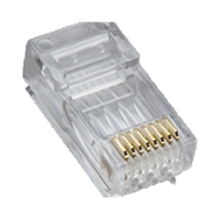
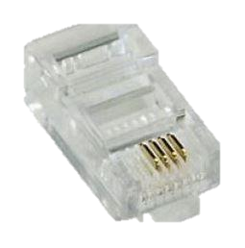
8P8C Connector
Often incorrectly referred to as “Ethernet” or “RJ45” connector
“8P” – 8 positions
“8C” – 8 contacts (i.e., all positions populated)
Compare 8P4C connector:

Slide 12
8P8C Connector
There are two ways to wire Cat 5e cable into 8P8C connectors; standards designated TIA/EIA-568A and TIA/EIA-568B
The most important thing is that both ends of a cable are wired the same

Slide 13
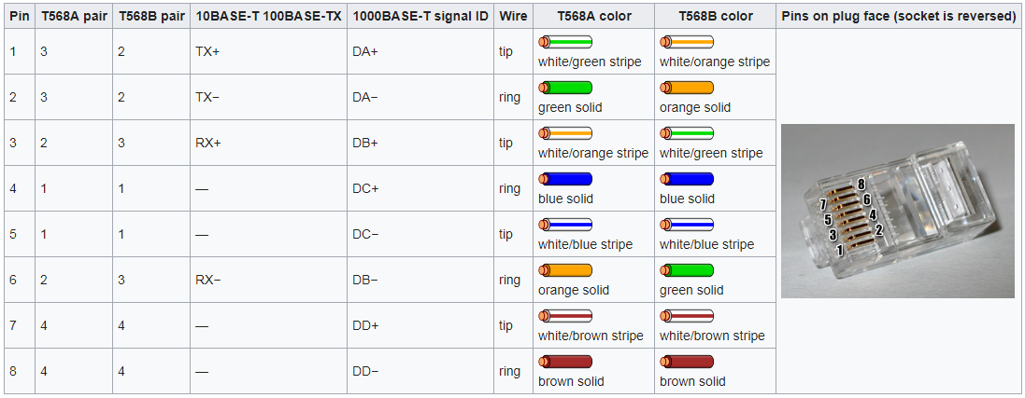
8P8C Connector
Note: 10 M and 100 M only use 2 of the 4 pairs, one in each direction. 1G uses all four pairs.

Slide 14
Power Over Ethernet
Allows power and data to run over the same cable
Two basic types: Alternative A and Alternative B
Alternative B uses the two unused pairs in 10BASE-T or 100BASE-T as dedicated power wires
Alternative A passes “phantom power” (exploits the differential signaling)

Slide 15
Power Over Ethernet
Alternative A
Two pairs are used for positive power, two for ground
Transformers block DC voltage, but pass differential pulses (data)

Slide 16
Power Over Ethernet
Standards (e.g. 802.3af) provide for powered devices to negotiate with power-supplying equipment to provide the amount of power needed
Some implementations use passive PoE (constant voltage supplied at all times)

Slide 17
Data Link Layer

Slide 18
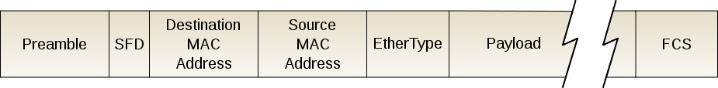
Ethernet
Ethernet properly refers to a frame structure which encapsulates data
Ethernet frames are sent from one MAC address to another

Slide 19
MAC Addresses
A MAC (Media Access Controller) address is the hardware address of a NIC (Network Interface Controller)
Compare IP addresses, which change depending on the network they’re connected to
64-bit number (2⁶⁴ possible; ≈10¹⁹)
Every NIC in the world should have a unique MAC address

Slide 20
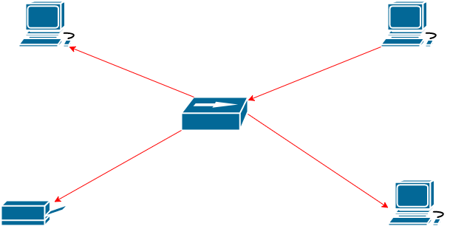
Ethernet Hubs
Hubs are active or passive devices which merely retransmit packets coming into one port to all the other ports
This is inefficient; all hosts receive all data
Raises the possibility of packet collisions

Slide 21
Ethernet Switches
Switches are “smart” devices
They can inspect the Ethernet frame header of incoming packets to see the source and destination MAC addresses
They build an internal table of which MAC addresses are on which ports
E.g., “I can reach 84:7B:EB:51:88:F9 on port 3.”
Thus, incoming packets are only retransmitted on the port their destination is connected to, not the whole network

Slide 22
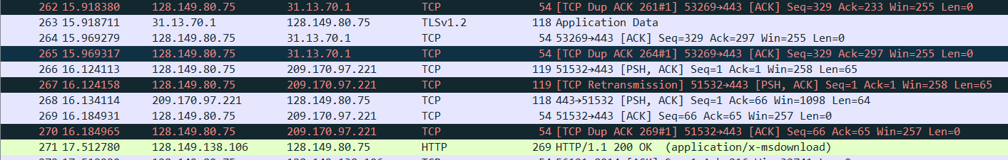
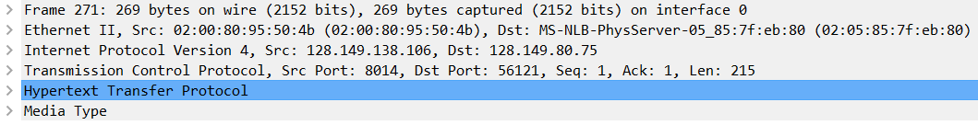
Wireshark
Packet analysis software
Captures packets from network adapter
Provides analysis of packets from Layer 2 up

Slide 23
Network Layer

Slide 24
Network Layer
Delivers packets from one logical address to another
Commonly used protocols are IPv4 and IPv6
IPv6 in the process of being adopted

Slide 25
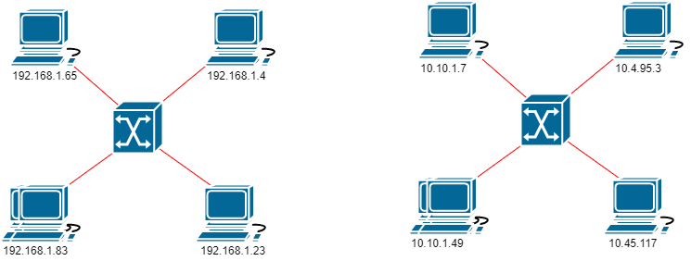
Network Layer
Hosts with logical addresses are connected together in networks

Slide 26
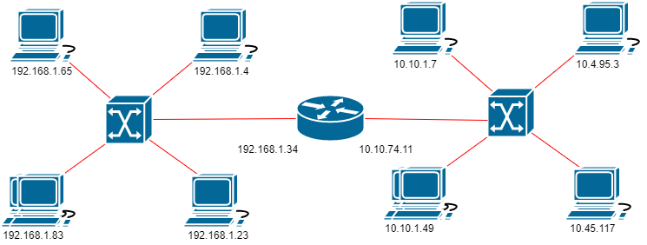
Network Layer
It is at this layer that multiple networks can be connected together into an internetwork
Packets are forwarded between networks by a router

Slide 27
IPv4 Addresses
32 bit number
Commonly represented in “dotted-quad” format
E.g. “192.168.1.56”
Can just as well be rendered as:
3232235832 (decimal)
C0A80138 (hex)
11000000101010000000000100111000 (binary)

Slide 28
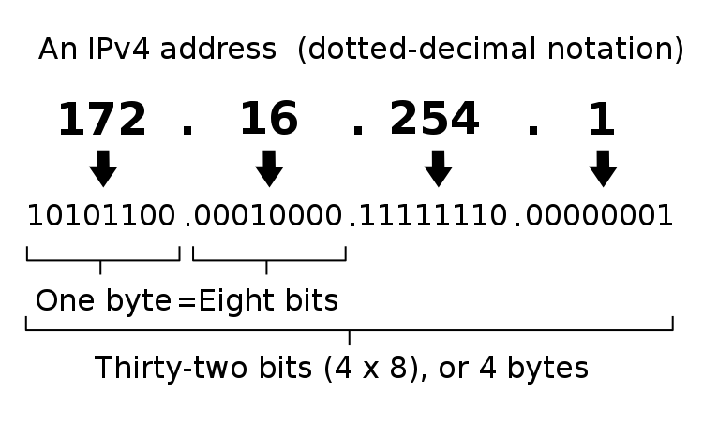
IPv4 Addresses

Slide 29
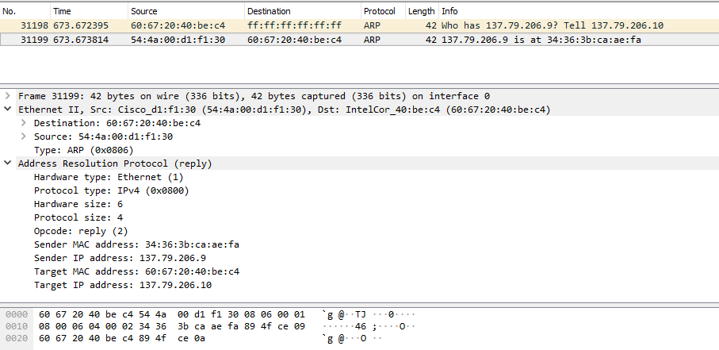
ARP
How IP addresses are associated to MAC addresses
Allows devices to build up a “phone book” of what MAC addresses are at what IPs

Slide 30
Subnetting
Describes what addresses are on same network (i.e., whether packets must go through a router)
32-bit IPv4 space gives 4,294,967,295 addresses
MANY more hosts than that in the world
An organization (e.g. your house) has a “gateway” with a single public IP that acts as a proxy between the internal network (your house, commonly 192.168.x.x) and the external network (the Internet)

Slide 31
Subnetting
If I’m a host at 192.168.1.23, and I have a message for 192.168.4.89, how do I know if I send it directly or through the gateway?
A subnet mask is a 32-bit number
Similar to IP address
However, it’s restricted to (in binary) some 1s followed by some 0s
E.g.
11111111111111111111111100000000
11111111111111111111000000000000
Never 11111111000011110000000000000000

Slide 32
Subnetting
The subnet mask tells you which bits of the destination address must match the source address to be local
Example:
192.168.1.23 = 11000000101010000000000100010111
192.168.4.89 = 11000000101010000000010001011001
Suppose a subnet mask of 255.255.255.0 = 11111111111111111111111100000000
Source: 11000000101010000000000100010111
Dest: 11000000101010000000010001011001
Mask: 11111111111111111111111100000000
Thus, the destination is NOT in the source’s subnet
If the subnet were 255.255.0.0 = 11111111111111110000000000000000
Source: 11000000101010000000000100010111
Dest: 11000000101010000000010001011001
Mask: 11111111111111110000000000000000
Then the destination WOULD be in the source’s subnet

Slide 33
Subnetting
Subnet masks are often aligned on byte boundaries
E.g., 255.0.0.0, 255.255.255.0
Makes mental subnetting easy:
192.168.0.0 with a subnet mask of 255.255.255.0 is addresses 192.168.0.0 – 192.168.0.255 (i.e., last byte is variable
192.168.0.0 with a subnet mask of 255.255.0.0 is addresses 192.168.0.0 – 192.168.255.255
Not necessarily, though
192.168.0.0 with a subnet mask of 255.255.240.0 is addresses 192.168.0.0 – 192.168.15.255

Slide 34
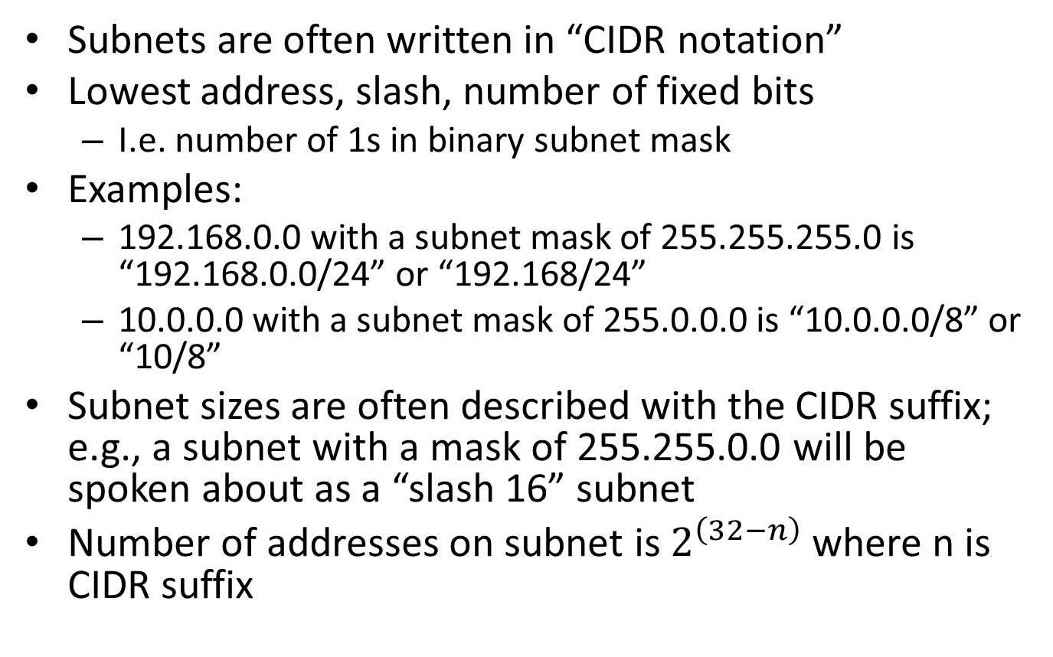
Subnetting
Subnets are often written in “CIDR notation”
Lowest address, slash, number of fixed bits
I.e. number of 1s in binary subnet mask
Examples:
192.168.0.0 with a subnet mask of 255.255.255.0 is “192.168.0.0/24” or “192.168/24”
10.0.0.0 with a subnet mask of 255.0.0.0 is “10.0.0.0/8” or “10/8”
Subnet sizes are often described with the CIDR suffix; e.g., a subnet with a mask of 255.255.0.0 will be spoken about as a “slash 16” subnet
Number of addresses on subnet is $2^{\left(32−n\right)}$ where n is CIDR suffix

Slide 35
RFC 1918
You don’t want, for example, a host with a public address of 192.168.1.23
If you’re on the 192.168.1.0/24 subnet, it’s ambiguous whether the message should be sent to the 192.168.1.23 on the local subnet, or the one on the Internet
IETF (Internet Engineering Task Force) publishes RFCs (Request For Comment) with recommended networking guidelines
RFC 1918 designates certain address ranges as private (i.e., only to be used in internal networks, never assigned as public IPs)

Slide 36
RFC 1918
Private address ranges:
10.0.0.0/8
172.16.0.0/12
192.168.0.0/24
Other non-publicly-routable addresses:
169.254.0.0/16
Autoconfiguration or link-local addresses; a host will often assign itself an address in this range if it was set up for DHCP, but couldn’t contact a DHCP server
Designated by RFC 3927
127.0.0.1
Loopback address; used to “talk to yourself”
Any traffic sent to this address gets returned to the sender (without ever going “on the wire”)
Specified by RFC 1132
Always associated with the hostname “localhost”

Slide 37
Routing
Routers are 2-or-more port devices
They forward packets between networks
Each port has an address on the network connected to it
E.g., your home router normally has one port on your private network (commonly 192.168.1.1), and one port on the public network (Internet)

Slide 38
Routing
To sent a packet to (for example) 8.8.8.8:
Your computer (192.168.1.2) sends a packet to your router (192.168.1.1)
Your router inspects the destination IP address and sees that the packet is headed to somewhere outside your private network
Your router sends the packet from its public address to 8.8.8.8

Slide 39
NAT
Network Address Translation
Allows many hosts (private network) to be communicate on the Internet with a single public IP

Slide 40
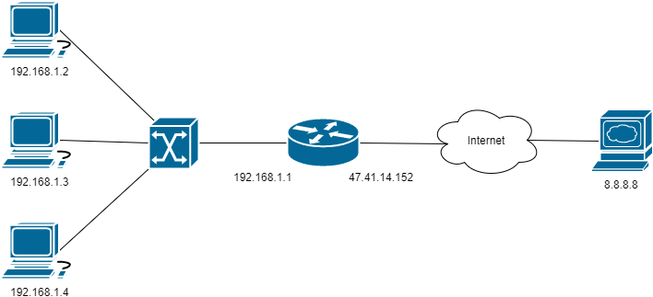
NAT
Example
You have a private IP of 192.168.1.2
Your router has a private IP of 192.168.1.1 and a public IP of 47.41.14.152

Slide 41
NAT
You send a message to 8.8.8.8
Your router rewrites the packet’s source to 47.41.14.152
Your router sends the packet to 8.8.8.8

Slide 42
NAT
8.8.8.8 sends a reply to 47.41.14.152
Your router rewrites the destination IP to 192.168.1.2
You receive the reply, apparently from 8.8.8.8

Slide 43
DHCP
“Dynamic Host Configuration Protocol”
Allows hosts to automatically get set up on new networks
The protocol itself is at Layer 7, but assigns Layer 3 addresses

Slide 44
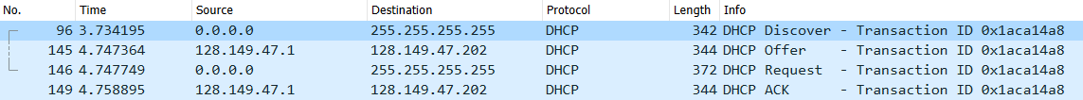
DHCP
A computer (without IP) sends a DHCP Discover to 255.255.255.255 (broadcast)
A DHCP server, if present, responds with an Offer (includes IP, subnet, gateway, etc.)
Server “leases” IP to client
Leases have configurable lifetime
When lease is about to expire, client must Renew

Slide 45
Transport Layer

Slide 46
Transport Layer
Sends segments between ports on hosts
Commonly-used protocols include UDP (User Datagram Protocol) and TCP (Transmission Control Protocol)

Slide 47
Ports
Logical “ports” are ways of segregating data between different applications on the same host
E.g., each connection to a website will use a different port on your computer

Slide 48
Ports
Ports 0-1024 are considered the well-known or reserved ports
Examples:
21 (FTP)
22 (SSH)
23 (Telnet)
53 (DNS)
80 (HTTP)
443 (HTTPS)

Slide 49
Ports
Higher-numbered ports (the lower limit varies) are known as ephemeral ports
They are dynamically allocated as requested by applications
E.g., if you have browsers open to www.google.com and www.team696.org, the connections may be between your port 41234 and google’s port 80 and between your port 59234 and team696’s port 80

Slide 50
Session Layer

Slide 51
Presentation Layer

Slide 52
Application Layer

Slide 53
DNS
Used to allow IP addresses to be referred to with hostnames
Remembering www.unitednuclear.com is easier than remembering 96.125.189.9
In order to be routed to the destination, hostnames need to be resolved to IP addresses

Slide 54
DNS
Two ways to resolve hostnames
Most computers have a “hosts” file
This is a bad way to do it; no easy way to distribute hostname changes
“Domain Name System”
Hierarchical network of servers (“nameservers”) which resolve hostnames to IPs

Slide 55
DNS
There are public DNS servers
Easy to remember: Google’s public nameserver at 8.8.8.8
Many organizations have internal nameservers
Allows access to internal services

Slide 56
DNS
Domains are hierarchical
Suppose you want to visit www.dus.jpl.nasa.gov
Root nameserver gives you the address for the “.gov” (TLDN) nameserver
.gov nameserver gives you the address for the nasa.gov nameserver
nasa.gov nameserver gives you the address for the jpl.nasa.gov nameserver
Etc…
Until you reach a nameserver that has the IP for the requested address (authoritative answer: “www.dus.jpl.nasa.gov is at 128.149.113.60”)

Slide 57
DNS
To cut down on traffic, DNS servers use caching
E.g., if the previous example was done through the 8.8.8.8 nameserver, in future, the nameserver would remember the resolution, and immediately reply with “www.dus.jpl.nasa.gov is at 128.149.113.60” (non-authoritative answer)
Cached values have TTL (time-to-live) values

Slide 58
DNS
For example, I bought the domain “696private.org” from Namecheap
I told Namecheap that DigitalOcean’s nameservers would serve the 696private.org domain
I then set up DNS records for 696private.org (and subdomains) on DigitalOcean’s nameservers

Slide 59
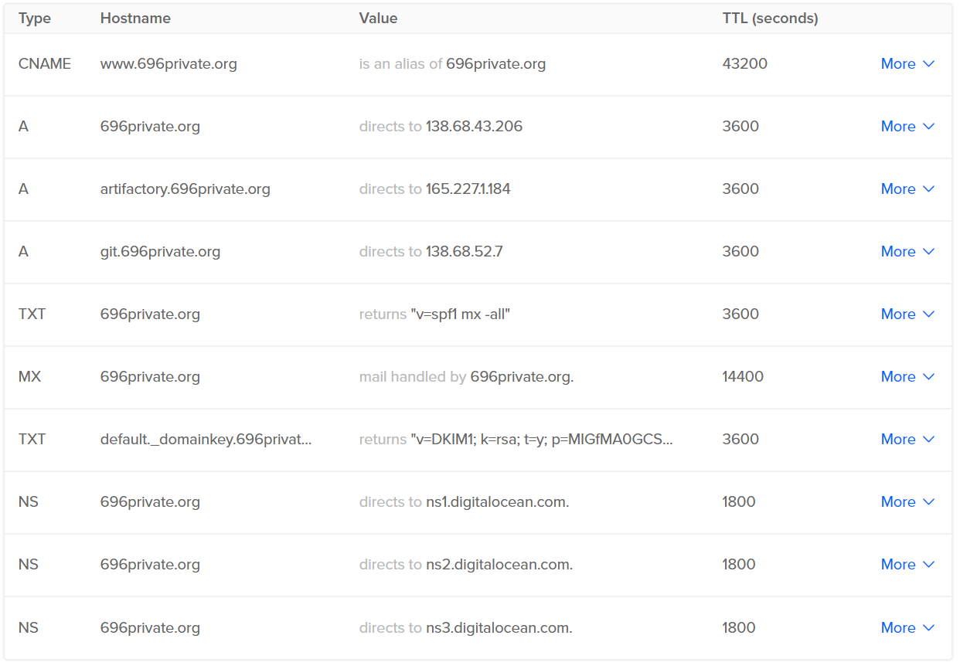
DNS

Slide 60
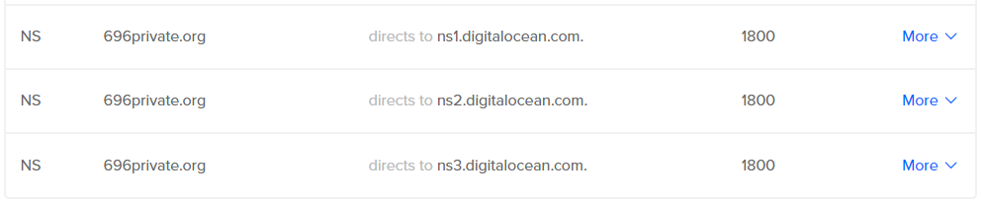
DNS
A records designate IPv4 addresses (Authoritative)
NS records give the nameserver(s) for a domain
MX records designate servers that handle e-mail going to a domain

Slide 61
DNS
CNAME records are aliases to other hostnames
TXT records store arbitrary data

Slide 62
WiFi
Physical layer protocol(s)
Standardized as IEEE 802.11
Generally uses 2.4 GHz or 5 GHz frequency bands
Defines 20 MHz or 40 MHz wide channels

Slide 63
WiFi
Generally, a radio acting as a wireless access point broadcasts an SSID (service set identification)
Clients (laptops, etc.) can associate with the WAP
In many cases, the WAP has an Ethernet port, to allow wifi clients to access a hardwired network

Slide 64
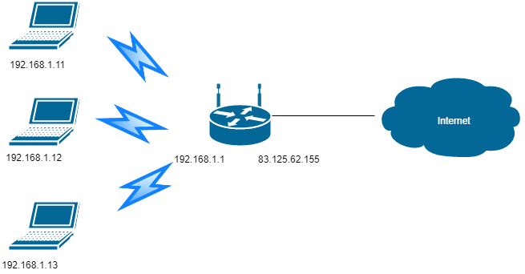
WiFi
Radios in “access point mode” generally implement a DHCP server and NAT, to allow clients to share a single public IP

Slide 65
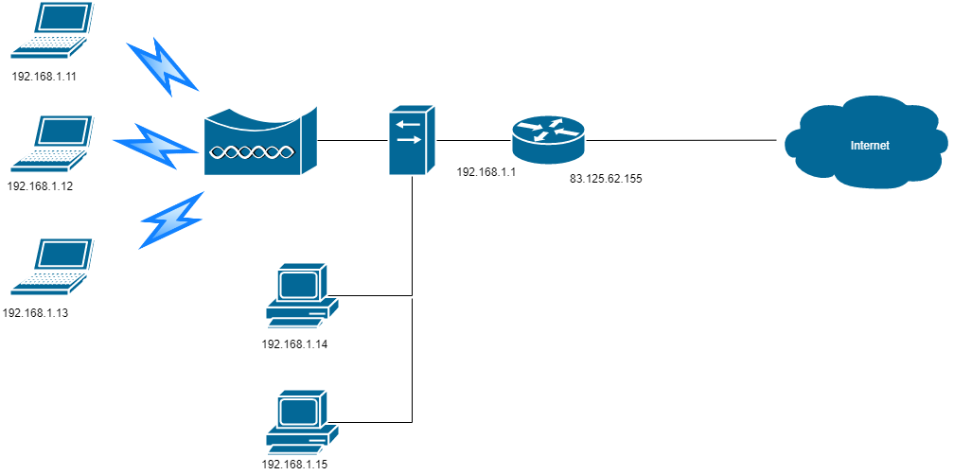
WiFi
Radios in “bridge mode” just connect wireless clients to a hardwired network

